Slide 1



Major Project Final Review
MATRUSRI ENGINEERING COLLEGE
Department of CSE
AI-IoT Enabled Disease Diagnosis Model for Smart Health Care Systems
B-21
Project Guide : Dr,Raghavendar Raju L, Asst professor
Student Names Roll No
1. Kavali srikanth 1608-20-733-103
2. Srikanth B 1608-20-733-113

Slide 2
Content Page
MATRUSRI ENGINEERING COLLEGE
Department of CSE
Content Page
Introduction
Motivation
Abstract
Problem Statement
Literature Review
Objectives
Methodology
Flow Chart
System Architecture
Technology Stack
Code
Execution
Conclusion

Slide 3
Introduction
MATRUSRI ENGINEERING COLLEGE
Department of CSE
Introduction
The project leverages AI and IoT to shift from reactive to proactive healthcare, enabling early detection, continuous monitoring, and personalized management of health conditions.
It aims to tackle rising healthcare costs, an aging population, and the increasing prevalence of chronic diseases by improving disease diagnostics and proactive health management.
The model uses advanced AI algorithms and a network of IoT devices, including wearable sensors, smart health monitors, and environmental sensors, for real-time health data collection and analysis.
By providing continuous monitoring and personalized insights, the AI-IoT enabled diagnostic model empowers individuals to actively manage their health, make informed decisions, and receive timely interventions.

Slide 4
Motivation
MATRUSRI ENGINEERING COLLEGE
Department of CSE
Motivation
The motivation behind the "Artificial Intelligence and Internet of Things Enabled Disease Diagnostic Model for Smart Healthcare Systems" is to leverage the capabilities of AI and IoT to transform healthcare delivery.
Addressing the increasing financial burden of healthcare by reducing costs through early diagnosis and preventive care.
Managing the growing incidence of chronic diseases with continuous monitoring and timely interventions.
Providing solutions for the increasing elderly population to maintain health and independence through remote monitoring.
Utilizing rapid advancements in AI and IoT to enhance healthcare efficiency, accuracy, and personalization.

Slide 5
Abstract
MATRUSRI ENGINEERING COLLEGE
Department of CSE
Abstract
This project, titled "Artificial Intelligence and Internet of Things Enabled Disease Diagnostic Model for Smart Healthcare Systems," leverages AI and IoT technologies to transform healthcare. By integrating advanced AI algorithms with IoT devices such as wearable sensors and health monitors, the model enables early disease detection, continuous health monitoring, and personalized management. This proactive approach aims to improve healthcare outcomes, reduce costs, and empower individuals to actively manage their health. The project addresses the challenges of rising healthcare costs, an aging population, and the prevalence of chronic diseases by providing timely interventions and personalized insights through real-time data analysis.

Slide 6
Problem Statement
MATRUSRI ENGINEERING COLLEGE
Department of CSE
Problem Statement
Fragmented Patient Data: Patient data is scattered across various sources, hindering quick access and comprehensive analysis.
Inefficient Diagnostic Processes: Manual diagnostic methods are time-consuming and prone to errors, resulting in delayed diagnoses and suboptimal treatments.
Reactive Healthcare Approach: Current systems primarily react to health issues instead of proactively identifying and addressing potential risks.
Lack of Proactive Solutions: There's a gap in proactive healthcare solutions that leverage AI and IoT for real-time analysis and personalized interventions.
Need for Transformative Solution: The healthcare sector requires an innovative AI-IoT disease diagnostic model to integrate data, improve accuracy, and empower both providers and patients for better outcomes.

Slide 7
Literature Survey
MATRUSRI ENGINEERING COLLEGE
Department of CSE
Literature Review
Hongxu Yin and Niraj K. Jha , 2017:
“A Health Decision Support System for Disease Diagnosis Based on Wearable Medical Sensors and Machine Learning Ensembles”
The study employs wearable medical sensors to collect real-time health data, which is processed using machine learning ensembles. These ensembles combine multiple machine learning models to enhance diagnostic accuracy by leveraging the strengths of each individual model.
Accuracy of 85%
2. Mehrbakhsh Nilashi, Othman Ibrahim, and Hedayatreza Naghshineh , 2020:
“Coronary Heart Disease Diagnosis through Self-Organizing Map and Fuzzy Support Vector Machine with Incremental Updates ”
This paper uses Self-Organizing Maps (SOM) for data visualization and clustering, combined with Fuzzy Support Vector Machines (FSVM) for classification. FSVM handles uncertainties in data through fuzzy logic, and incremental updates allow the model to adapt over time.
Accuracy of 82.17%

Slide 8
Literature Survey
MATRUSRI ENGINEERING COLLEGE
Department of CSE
Literature Review
3. : Uma N. Dulhare 2018:
“Prediction System for Heart Disease Using Naive Bayes and Particle Swarm Optimization ”
This study employs the Naive Bayes classifier optimized by Particle Swarm Optimization (PSO). PSO improves feature selection, enhancing the predictive performance of the Naive Bayes classifier.
Accuracy of 90.76%
4. Hasan T. Abbas, Ping H. Tan, Paul P. Wang, and Josephine M. E. Raymond , 2019:
“Predicting Long-Term Type 2 Diabetes with Support Vector Machine Using Oral Glucose Tolerance Test ”
This study uses Support Vector Machines (SVM) for predicting long-term type 2 diabetes, based on data from Oral Glucose Tolerance Tests (OGTT). SVM is chosen for its robustness and high classification accuracy.
Accuracy of 85%

Slide 9
Objectives
MATRUSRI ENGINEERING COLLEGE
Department of CSE
Objectives
Integrated Data Management: Systemize data aggregation from diverse sources like medical records, IoT devices, and lab results.
Efficient Diagnosis: Employ AI algorithms to automate diagnostics, enhancing accuracy and expediting processes.
Proactive Healthcare Delivery: Utilize predictive analytics for preemptive identification of health risks, enabling proactive interventions.
Personalized Treatment Plans: Tailor treatment strategies based on individual patient data, optimizing healthcare outcomes.
Continuous Improvement: Establish protocols for ongoing system evaluation and refinement to ensure long-term effectiveness.

Slide 10
Methodology
MATRUSRI ENGINEERING COLLEGE
Department of CSE
Methodology
Data Collection and Preprocessing:
The first step involves collecting comprehensive datasets that include patient records, medical histories, and diagnostic images relevant to heart and lung diseases. This data is sourced from hospitals, medical institutions, and publicly available healthcare databases.
Cleaning, Removing any missing or erroneous data entries.
∙ Normalization, Standardizing the data to ensure uniformity in scale and distribution. ∙ Encoding, Converting categorical data into numerical format for compatibility with machine learning algorithms.
∙ Balancing, Addressing any class imbalances in the dataset to prevent biased model predictions.
Integration with SQLite :
An SQLite database is integrated to store user information, diagnostic results, and other relevant data. This involves, Database Schema, Designing tables and relationships to manage user data and diagnostic records. Implementing Create, Read, Update, and Delete operations to manage data efficiently.

Slide 11
MATRUSRI ENGINEERING COLLEGE
Department of CSE
Methodology
Integration with Flask:
Flask, a lightweight web application framework, is used to create a user-friendly
Creating Routes, Defining endpoints for uploading data, running predictions, and displaying results.
∙ Handling Requests, Implementing logic to process incoming requests, invoke the machine learning models, and return predictions.
∙ User Interface, Developing HTML templates for the index, login, register, and results pages to facilitate user interactions.
Front-End Development :
Login and Register Pages, Allowing users to create accounts and log in securely. ∙ Index Page, Providing an overview of the application's features and functionalities. ∙ Results Page, Displaying the diagnostic results along with relevant visualizations and insights. HTML, CSS, and JavaScript are used to create responsive and interactive web pages.

Slide 12
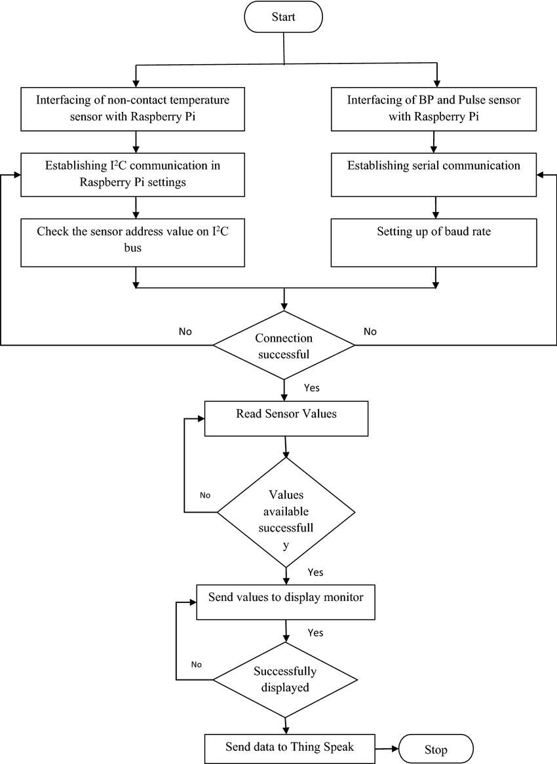
Flow Chart
MATRUSRI ENGINEERING COLLEGE
Department of CSE
Flow Chart

Slide 13
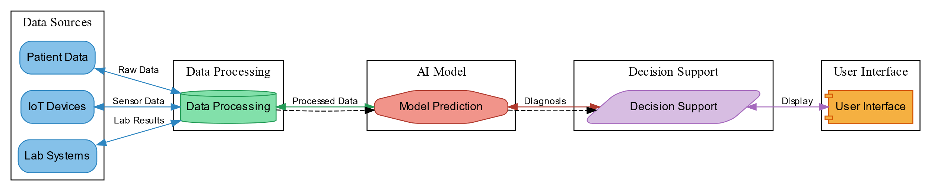
System Architecture
MATRUSRI ENGINEERING COLLEGE
Department of CSE
System Architecture

Slide 14


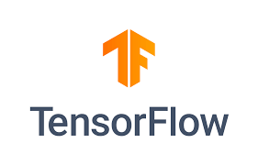



Technology Stack
MATRUSRI ENGINEERING COLLEGE
Department of CSE
Technology Stack
BACKEND
FRONTEND
TOOLS

Slide 15
Code
MATRUSRI ENGINEERING COLLEGE
Department of CSE
Code
Library used:
Keras: loading Model
Cv2: resize image
Numpy: to convert image to array
Flask: for integration
Inferences: YOLO model
Supervision: Bounding boxes

Slide 16
Code
MATRUSRI ENGINEERING COLLEGE
Department of CSE
Code
Code
App.py
Dense_net_prediction()
Yolo_Predict()
Index.Html
Display_output()
Select_image()
main()
Captureliveimage()

Slide 17
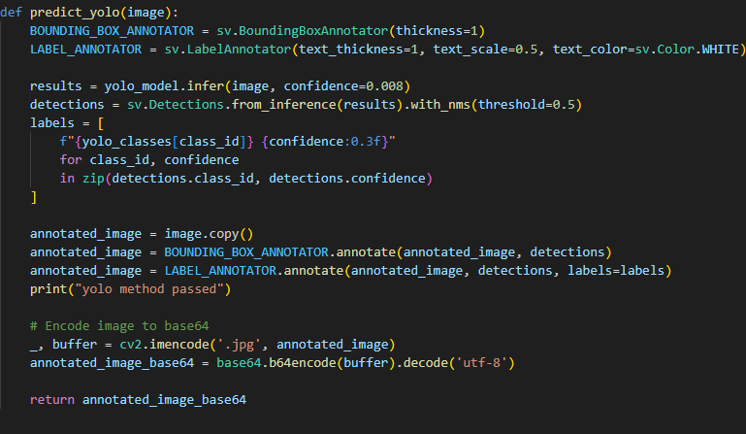
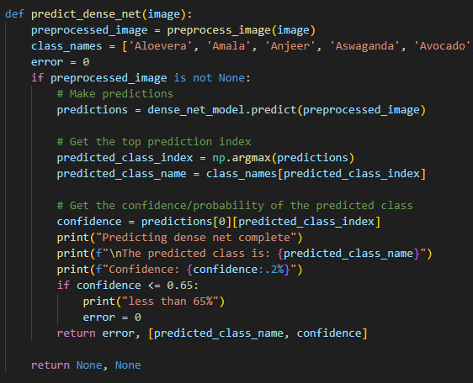
Code
MATRUSRI ENGINEERING COLLEGE
Department of CSE
Code

Slide 18
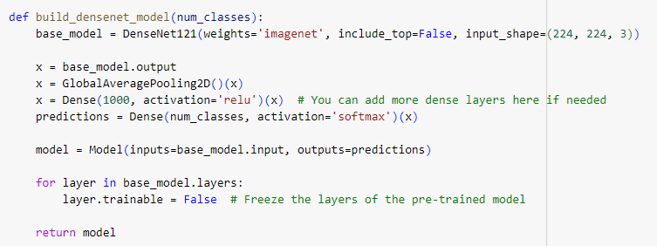
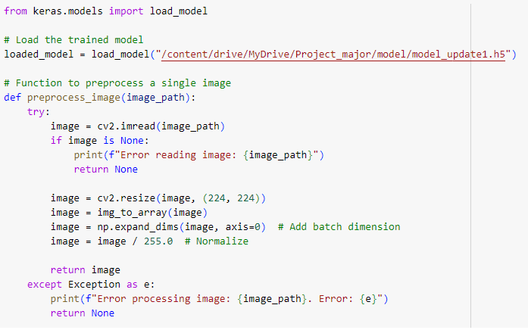
Code
MATRUSRI ENGINEERING COLLEGE
Department of CSE
Code

Slide 19
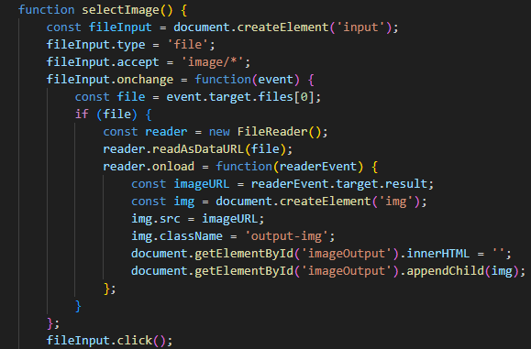
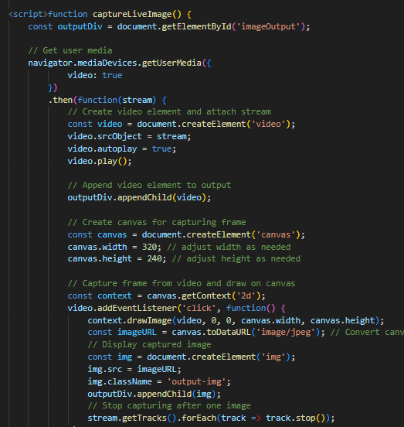
Code
MATRUSRI ENGINEERING COLLEGE
Department of CSE
Code

Slide 20
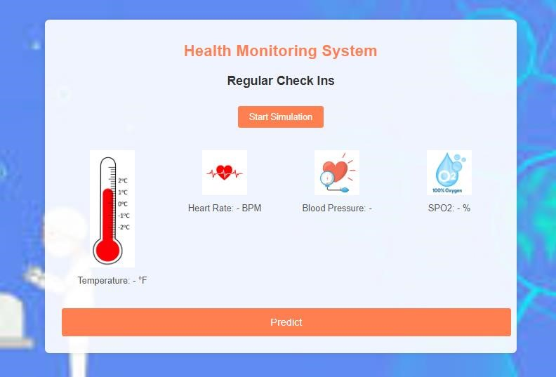
Execution
MATRUSRI ENGINEERING COLLEGE
Department of CSE
Execution

Slide 21
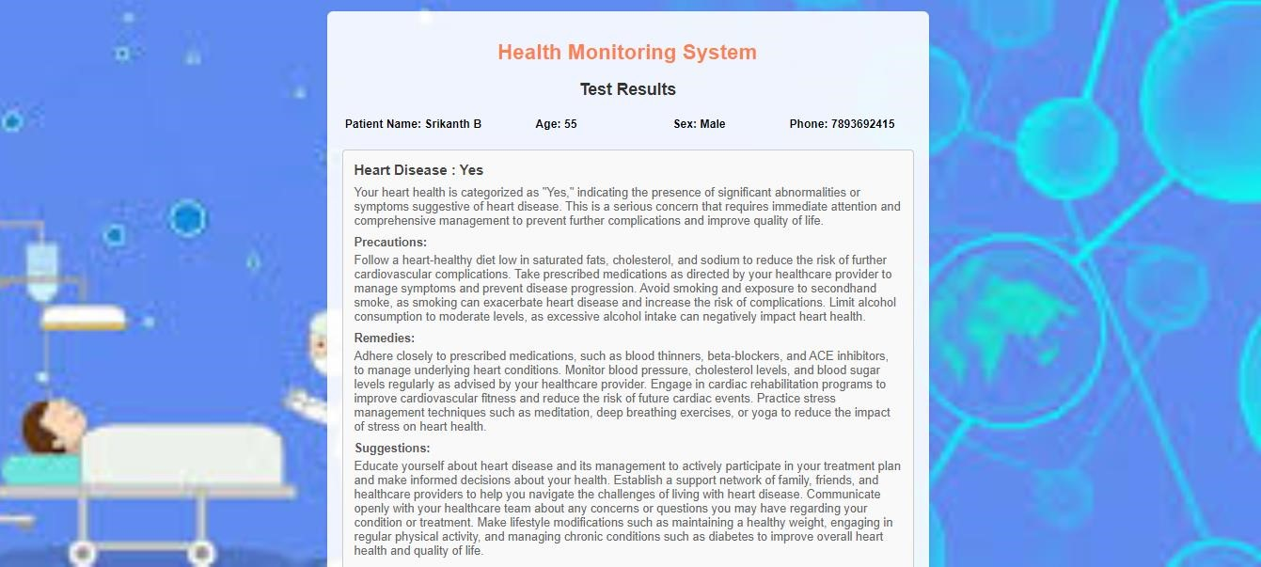
Execution
MATRUSRI ENGINEERING COLLEGE
Department of CSE

Slide 22
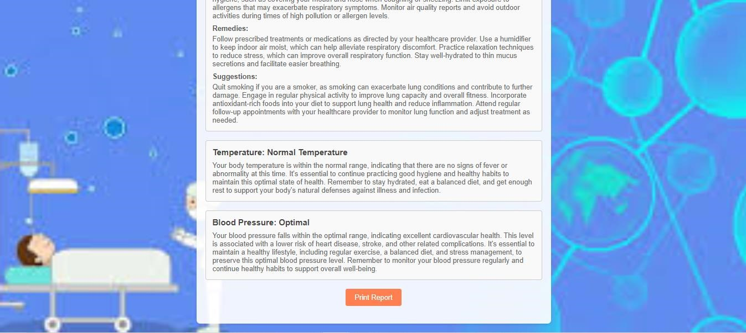
MATRUSRI ENGINEERING COLLEGE
Department of CSE
Execution

Slide 23
Conclusion
MATRUSRI ENGINEERING COLLEGE
Department of CSE
Conclusion
In summary, the AI-IoT Disease Diagnostic Model embodies a revolutionary leap in healthcare, addressing the pressing challenges of fragmented data, sluggish diagnostics, and reactive healthcare practices. By seamlessly integrating AI algorithms with IoT technologies, the model streamlines data management, enhances diagnostic precision, and pioneers proactive healthcare delivery. Tailored treatment plans, driven by comprehensive patient data, promise personalized care at scale, while an intuitive user interface fosters seamless collaboration among stakeholders. Bolstered by continuous refinement protocols, this model stands as a beacon of innovation, poised to redefine healthcare delivery paradigms, elevate patient outcomes, and catalyze transformative advancements in the field.

Slide 24
MATRUSRI ENGINEERING COLLEGE
Department of CSE
THANK YOU

